Slide 1
How can masks prevent the transmission of germs through the air?
week

Slide 2
How are germs spread?

Slide 3
How can we stop germs from spreading?
Educate people how to protect themselves and others.
Design devices and other things that stop germs from spreading.
Notes:
Engineering
Find a problem
design a solution
Optimize the solution
Engineering is solving problems using different tools. (STM)

Slide 4
What do we need in order to make this happen?
Find the materials we need and calculate the quantities of each material.
Notes:
Engineering
Find a problem
design a solution
Optimize the solution
Engineering is solving problems using different tools. (STM)

Slide 5
Technology
Create and test what we created
Notes:
The simplest form of technology is the development and use of basic tools.

Slide 6
How can we stop germs from spreading?

Slide 7
The SARS-Cov-2 virus
Causes the disease COVID-19.
COVID-19 is caused by a type of coronavirus.
There are many types of coronaviruses, including the virus that causes the common cold.
Source

Slide 8
Reproduction number
R: How many people are infected from an ill individual before he recovers or dies.
Just how contagious is COVID-19?
This chart puts it in perspective

Slide 9
How fast COVID-19 spreads?

Slide 10
What do we use in order to stop COVID-19 from spreading?
Soap
Alcohol based solutions
Bleach
Face masks

Slide 11
Air filter technology
How can we stop COVID-19 from spreading?

Slide 12
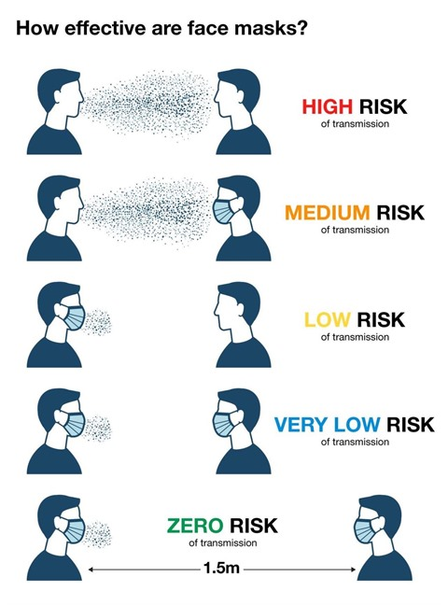
How effective are face masks?
https://www.gannawarra.vic.gov.au/News-Media/Wear-a-mask-and-help-stop-the-spread-of-COVID-19

Slide 13
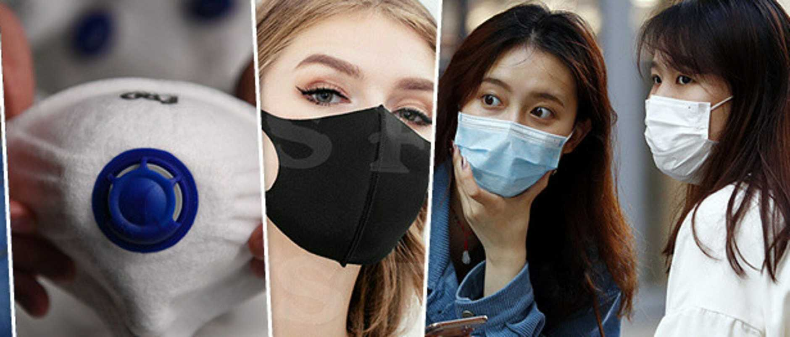
What is the technology behind the face masks?
Surgical masks are today manufactured using non-woven fabrics made from plastics like polypropylene to filter and protect.
They are available in many different styles and grades depending on the level of protection the user requires.

Slide 14
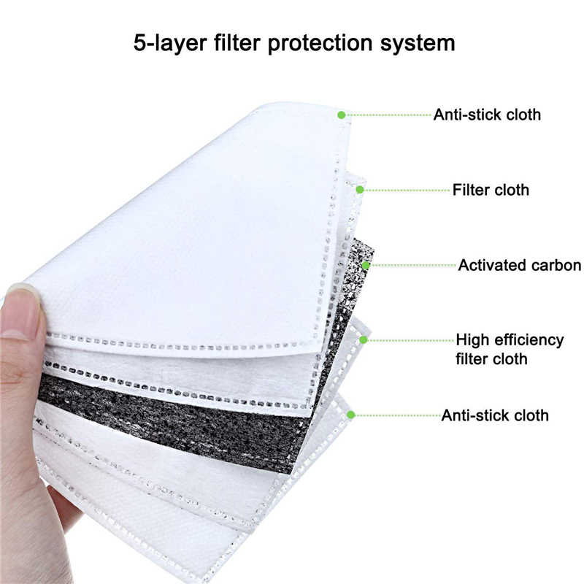
Materials of surgical masks

Slide 16
Cotton masks
CDC recommends wearing cloth face coverings in public settings where other social distancing measures are difficult to maintain. Cloth face coverings fashioned from household items or made at home from common materials at low cost can be used as an additional, voluntary public health measure.

Slide 17
Cotton masks
In the case of influenza, the median-fit factor of the homemade masks was one-half that of the surgical masks. Both masks significantly reduced the number of microorganisms expelled by volunteers, although the surgical mask was 3 times more effective in blocking transmission than the homemade mask.

Slide 18
Hands-on STEM!

Slide 19
How to make your own face mask
Materials needed:
T-shirt
Scissors
OR
Bandana (or square cotton cloth approximately 20”x20”)
Rubber bands (or hair ties)
Scissors (if you are cutting your own cloth)

Slide 20
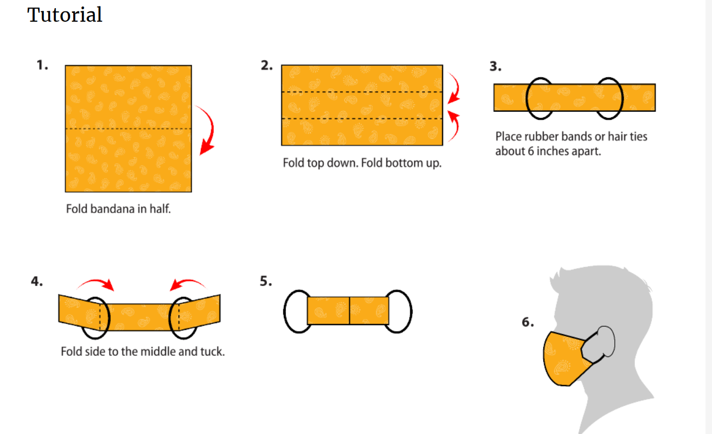
Steps to follow!

Slide 21
Cloth face masks must be used as follows:
Regularly washed in 60ºC
Individuals should be careful not to touch their eyes, nose, and mouth when removing their face covering and wash hands immediately after removing.

Slide 22
www.who.int/docs/default-source/coronaviruse/risk-comms-updates/update39-covid-and-schools.pdf

